Slide 1
Axiomatic Semantics
CMSC 330: Programming Languages

Slide 2
What is Axiomatic Semantics?
A mathematical framework to reason about programs
Defines program meaning using assertions about program state
Provides a formal basis to reason about program correctness
Typical Assertions (Examples)
  Program terminates
  If program terminates, variables x and y have the same value throughout execution
  Array accesses are within array bounds
  Loop invariants: x > 0 before each iteration

Slide 3
Why Learn Axiomatic Semantics?
Helps reason formally about program behavior
Useful for reliable software, documentation, and safe programming practices
Proving the correctness of algorithms
Proving the correctness of hardware descriptions
Extended static checking
  Checking array bounds
  Checking access of uninitialized data
  Use-after-free detection

Slide 4
History
Introduced by C.A.R. Hoare (1969) — “An Axiomatic Basis for Computer Programming”
“Thus the practice of proving programs would seem to lead to solution of three of the most pressing problems in software and programming, namely, reliability, documentation, and compatibility.”
First formal approach to reason about correctness using logic
Introduced the concept of Hoare triples {P} s {Q}

Slide 5
Core Terms in Axiomatic Semantics
Program State
  The values of all variables in an instance of a running program
Assertion
  A logical statement about the program state we expect to hold during execution
Precondition
  Assertion that must hold before executing a statement or procedure
Postcondition
  Assertion that should hold after execution (for partial correctness, assume the program terminates)

Slide 6
Hoare Triple
Hoare Triple: {P} s {Q}
P: precondition
  P holds in some initial state
s: program statements being run
Q: postcondition
  Q holds after the execution of s
E.g., { y <= x } z := x ; z := z + 1 { y < z }

Slide 7
Hoare Triple: Example
{ x == 2, y == 3 } x = x + 1 { x == 3, y == 3 }
{ x == 2, y == 3 } if (x > 3) {y = y + 1} { x == 2, y == 3 }

Slide 8
Partial vs Total Correctness
Partial Correctness:
  Hoare triple: {P} s {Q}
  Meaning: If the program s is executed from a state satisfying P and s terminates, then Q will hold afterward
  We are trying to compute the precondition P that ensures Q holds if s terminates
  Captured by wlp(s, Q) — the weakest liberal precondition: the most general precondition that guarantees Q upon termination

Slide 9
Partial vs Total Correctness
Total Correctness
  Hoare triple with termination: {P} s {Q} + termination
  Meaning: If the program s is executed from a state satisfying P, then s terminates and Q holds afterward
  We are trying to compute the precondition P that guarantees s terminates and Q holds
  Captured by wp(s, Q) — the weakest precondition: the most general precondition that guarantees termination and Q

Slide 10
Hoare Triple: More Examples
Determine whether each Hoare triple is true or false assuming partial correctness
{x == 1} x = x + 1 {x == 2, y == 3}
{x == y + 1} x = x + 1 {x == y}
{x == y + 1} y = y + 1 {x == y}
{x > y} if (x > 3) {x = x + 1} {x > y}
{x == 10} while (x > 0) {x = x + 1} {x == 2}
Notes:
F
F
T
T
T (hint, no termination, so false -> anything is true)

Slide 11
Weakest Liberal Precondition (wlp)
Hoare triple: {A} s {B}
  s : statement being executed
  B : postcondition (what we want after s)
  A : weakest liberal precondition — the least restrictive assertion that guarantees: If s terminates, then B holds afterward
Key points:
  A is the precondition we need for partial correctness
  Termination of s is not required
  wlp helps us reason about correctness without worrying about loops terminating

Slide 12
WLP Example
a = b + 1 { a > 1 }
One possible precondition: { b > 10}
But what is the weakest liberal precondition?
{ b > 0}

Slide 13
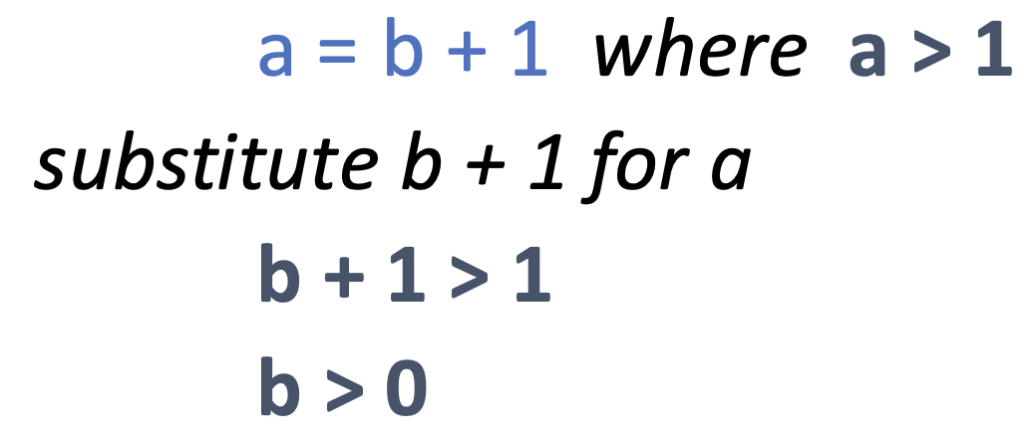
Finding WLP Case 1: Simple Assignment
Case 1: {P} x=E {Q}
wlp(x=E, Q) = Q[E/x]
  Replace every occurrence of x in Q with the expression E
Notes:
Try: {wlp?} x=x*x +10 {x is a prime}
Solution: x*x + 10 is a prime

Slide 14
Finding WLP Case 2: Sequential Composition
Case 2: {P} s1; s2; {Q}
wlp(s1​;s2​, Q) = wlp(s1​, wlp(s2​, Q))
Try:
x=x+1; y=x {y==2}
Notes:
X ==1

Slide 15
Finding WLP Case 3: Conditional Statement
Case 3: {P} if (c){s1} else {s2} {Q}
wlp(if (c) {s1}​ else {s2}​, Q) = (c ∧ wlp(s1​, Q)) ∨ (¬c ∧ wlp(s2​, Q))
wlp(if (c) {s1}, Q) = (c ∧ wlp(s1, Q)) ∨ (¬c ∧ Q)
  Try it with wlp(skip, Q) = Q
Try:
if (x > 0) {x = x + 1} {x >= 1}
Notes:
X > 0

Slide 16
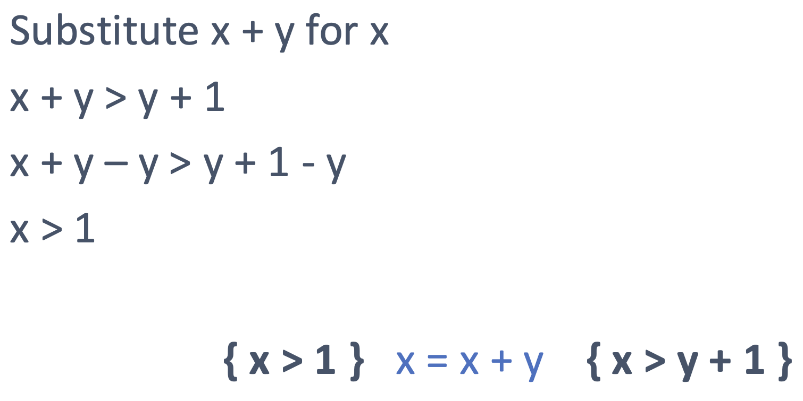
Exercise
Compute the wlp for x = x + y {x > y + 1}

Slide 17
Exercise
Prove that the following program specification is correct
{ y > 3 } y = 2*y { y > 6 }
Try it
But what if I had asked
{ y > 5 } y = 2*y { y > 6 }

Slide 18
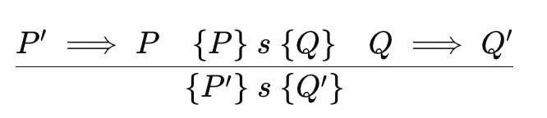
Consequence Rule
Allows strengthening preconditions or weakening postconditions
If we know {P} s {Q}, then any P' stronger than P and Q' weaker than Q also works
=> means “logically implies”
Notes:
Can also be partially used, like P’ => P {P} s {Q} ---------- {P’} s {Q}
Inference Rules: if the above is true, then the truth of the bottom can be inferred

Slide 19
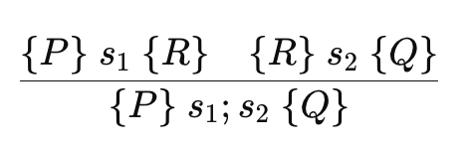
Sequential Composition Rule
For executing statements one after another

Slide 20
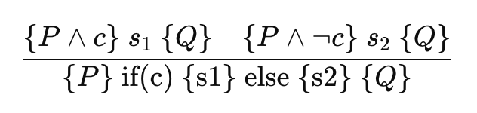
Conditional (If-Else) Rule
For a full if(c){s1} else {s2} statement
Check both branches separately

Slide 21
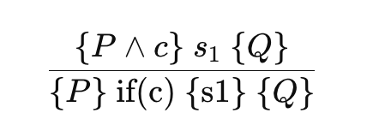
Conditional (If only) Rule
For if(c) {s1} with no explicit else
The implicit else is skip → wlp(skip, Q) = Q

Slide 22
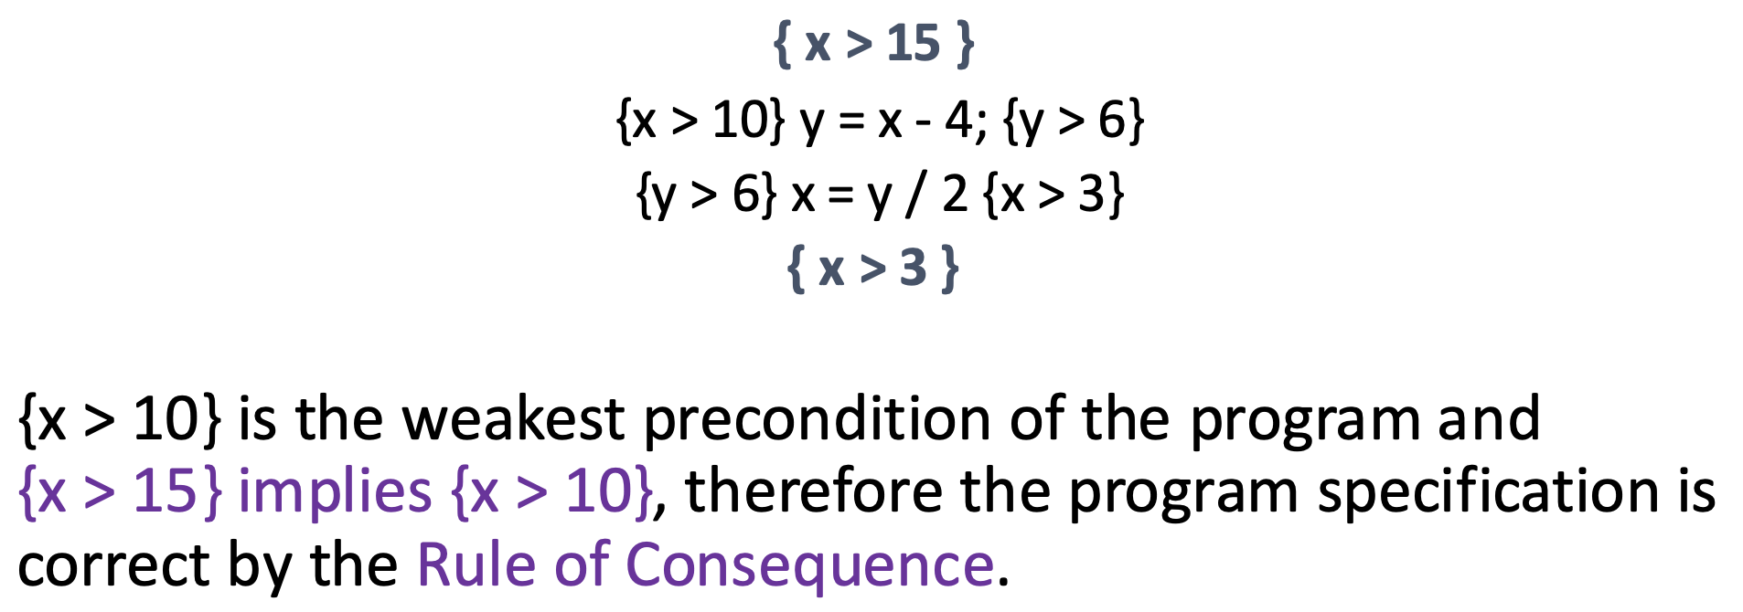
Exercise
Prove that the following program specification is correct
{ y > 5 } y = 2*y { y > 6 }
{ x > 15 } y = x - 4; x = y / 2 { x > 3 }

Slide 23
Exercise
Compute the wlp for the following statement and postcondition:
if (a == b) {b = 2 * a + 1} else {b = 2 * a} { b > 2 }
Notes:
(a==b∧a>1/2)∨(a=b∧a>1)

Slide 24
Finding WLP Case 4: Loops
Case 4: {P} while (c) {s} {Q}
P and Q can share a common logical component called the loop invariant (I) or inductive hypothesis, which is true before and after the loop execution
You define an invariant I such that:
  Initially, P ⟹ I (so I is true before the loop starts)
  {I ∧ c} s {I} (so I is true for every loop iteration)
  At the end, we have I ∧ ¬c ⟹ Q (¬c terminates the loop)
  Then, wlp (while (c) {s}, Q) = I
Notes:
Serves as a precondition
When combined with !B implies the postcondition

Slide 25
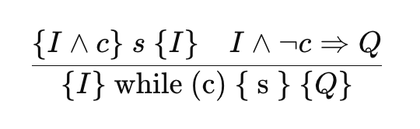
Loop Invariant Rule (Partial Correctness)
Additionally, P => I
Termination is NOT required (partial correctness)

Slide 26
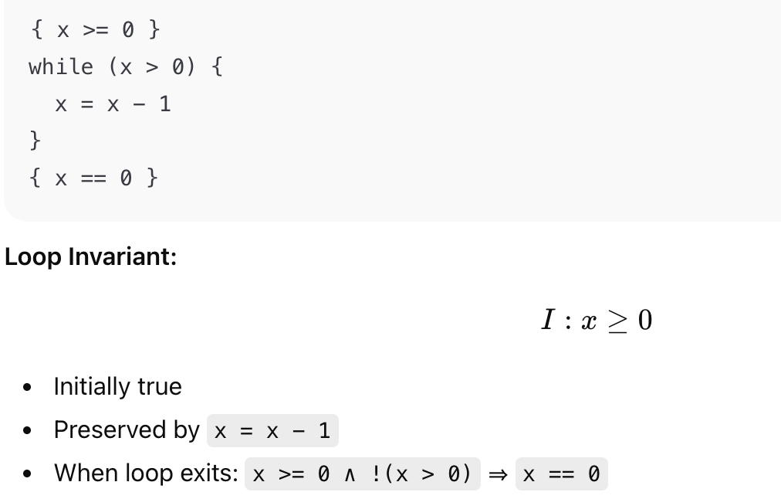
Loop Invariant Example

Slide 27
Loop Invariant Example
Prove:
{ i <= 10 } while (i < 10) { i = i + 1;} { i == 10 }
Use the invariant I: i <= 10
Check:
  P => I (True: i <= 10 => i <= 10 )
  {I ^ c} s {I} (True: try it using case 1)
  I ^ ¬c => Q (True: i <= 10 and i >=10 => i == 10)

Slide 28
Loop Invariant Example
Usually, we’ll have some postcondition and we’ll be trying to find a loop invariant and therefore determine the precondition. What could we use for I?
{ ? } while (x != y) {y = y + 1;} { x == y }
We want an I such that
  Precondition ⇒ I
  { I ∧ x != y } y = y + 1 { I }
  I ∧ !(x != y) ⇒ x == y
I: y ≤ x
Notes:
x never changes
y increases each time
Loop stops when y == x

Slide 29
Loop Invariant Example
Prove:
    { i == 0 ∧ sum == 0 }
    while (i < n) {
    i = i + 1;
    sum = sum + i;
    }
    { sum >= 0 }
Use I: i ≤ n ∧ sum ≥ 0
Check:
  P => I
  {I ^ c} s {I}
  I ^ ¬c => Q

